Slide 1
HW07 Report
Sai V. Mudumba
April 23, 2021

Slide 2
Note
Implementing Natural Language Processing networks and mechanisms with only 1-week of lectures on it was very difficult to grasp, since Recurrent Neural Networks (RNN) work differently to Convolutional Neural Networks (CNN)
Hence, with limited exposure to RNN, GRU, LSTM, etc. I have to admit this HW felt more abstract and confusing to understand than the past HWs, probably exacerbated by the end of the semester stress

Slide 3
Task 1
For this task, I ran TaskNet, TaskNetWordEmbedding with Google-300 dataset, TaskNetWordEmbedding with Twitter-200 dataset

Slide 4
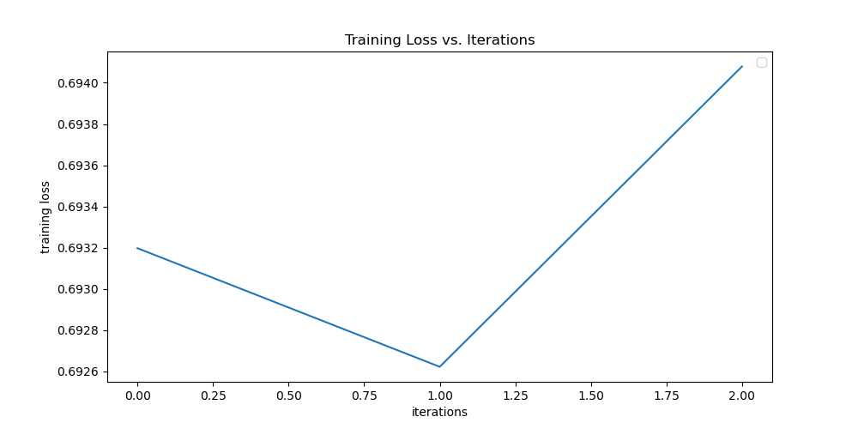
text_classification_with_TEXTnet.py
Training:
Number of layers in the model = 6
Number of learnable parameters in the model = 10,718,770
Size of the vocabulary (i.e., the one-hot encoding vector) = 17,001
Epochs = 1
Batch size = 1
Testing:
Overall classification accuracy = 51%
Number of positive reviews tested = 200
Number of negative reviews tested = 195
Displaying the confusion matrix:
predicted negative predicted positive
true negative: 0.0 100.0
true positive: 0.0 100.0

Slide 5
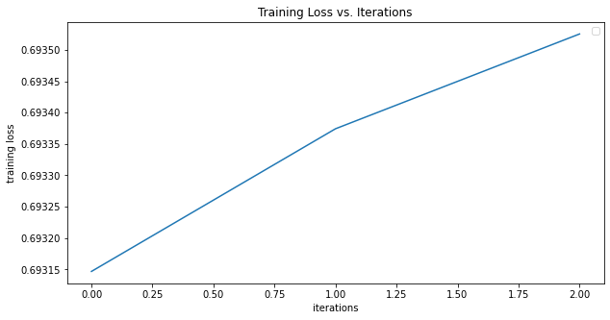
text_classification_with_TEXTnet_word2vec.py
Training:
Number of layers in the model = 6
Number of learnable parameters in the model = 497,758
Epochs = 1
Batch size = 1
Testing:
Overall classification accuracy = 52%
Number of positive reviews tested = 200
Number of negative reviews tested = 195
Displaying the confusion matrix:
predicted negative predicted positive
true negative%: 85.128% 14.872%
true positive%: 80.5% 19.5%

Slide 6
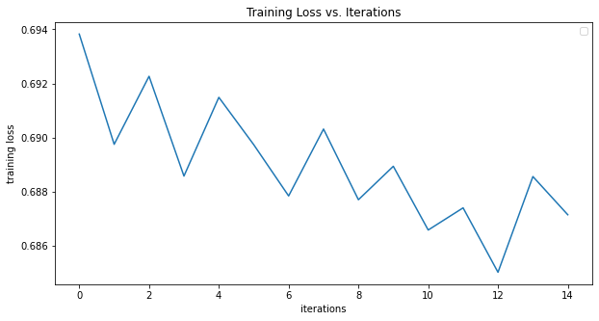
text_classification_with_TEXTnet_GloVe_word2vec.py
Using the network and code provided in DLStudio’s TextClassificationWithEmbeddings Class but by downloading the glove-twitter-200 dataset instead of word2vec-google-news-300:
Training:
Number of layers in the model = 6
Number of learnable parameters in the model = 436,558
Epochs = 5
Batch size = 1
Testing:
Overall classification accuracy = 54.31%
Number of positive reviews tested = 200
Number of negative reviews tested = 195
Displaying the confusion matrix:
predicted negative predicted positive
true negative%: 51.282% 48.718%
true positive%: 43.0% 57.0%
Example Test Output:
['this', 'has', 'a', 'wonderfully', 'intense', 'ginger', 'flavor', 'without', 'managing', 'to', 'be', 'overwhelming', 'i', 'cannot', 'speak', 'about', 'its', 'effectiveness', 'in', 'combatting', 'motion', 'sickness', 'though', 'it', 'did', 'do', 'a', 'good', 'job', 'settling', 'an', 'upset', 'stomach', 'that', 'being', 'said', 'whatever', 'ends', 'up', 'getting', 'you', 'interested', 'in', 'this', 'product', 'whether', 'it', 'be', 'the', 'flavor', 'or', 'the', 'other', 'properties', 'of', 'ginger', 'this', 'is', 'definitely', 'a', 'candy', 'you', 'will', 'want', 'in', 'your', 'candy', 'dish', 'desk', 'etc', 'my', 'only', 'suggestion', 'is', 'to', 'buy', 'more', 'than', 'one', 'at', 'a', 'time', 'because', 'the', 'flavor', 'is', 'so', 'good', 'that', 'you', 'will', 'go', 'through', 'these', 'rather', 'quickly']
[i= 300] predicted_label=1 gt_label=1

Slide 7
TASK 2
Running TextnetOrder2WithEmbeddings
Running GRUnetWithEmbeddings

Slide 8
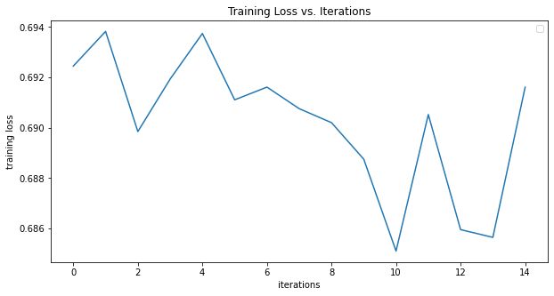
text_classification_with_TEXTnetOrder2WithEmbeddings_GloVe
Using the network and code provided in DLStudio’s TEXTnetOrder2WithEmbeddings Class but by downloading the glove-twitter-200 dataset instead of word2vec-google-news-300:
Training:
Number of layers in the model = 8
Number of learnable parameters in the model = 1,012,558
Epochs = 5
Batch size = 1
Hidden size = 512
Testing:
Overall classification accuracy = 51.02%
Number of positive reviews tested = 200
Number of negative reviews tested = 195
Displaying the confusion matrix:
predicted negative predicted positive
true negative: 26.154% 73.846%
true positive: 25.0% 75.0%
Example Test Output:
['at', 'mm', 'this', 'lens', 'is', 'very', 'soft', 'its', 'hard', 'to', 'get', 'a', 'shot', 'that', 'looks', 'like', 'its', 'in', 'focus', 'to', 'do', 'so', 'you', 'need', 'to', 'shoot', 'at', 'about', 'f', 'and', 'then', 'since', 'there', 'is', 'little', 'light', 'available', 'you', 'usually', 'have', 'to', 'bump', 'the', 'iso', 'to', 'or', 'just', 'to', 'get', 'an', 'acceptable', 'shutter', 'speed', 'of', 'course', 'the', 'high', 'iso', 'then', 'introduces', 'other', 'artifacts', 'the', 'focus', 'is', 'also', 'dead', 'slow', 'and', 'often', 'doesnt', 'lock', 'on', 'this', 'is', 'a', 'lens', 'that', 'i', 'have', 'constantly', 'fought', 'with', 'dont', 'upgrade', 'to', 'the', 'new', 'is', 'either', 'as', 'its', 'only', 'marginally', 'betterbuy', 'the', 'fl', 'its', 'a', 'far', 'superior', 'lens']
[i= 200] predicted_label=1 gt_label=0

Slide 9
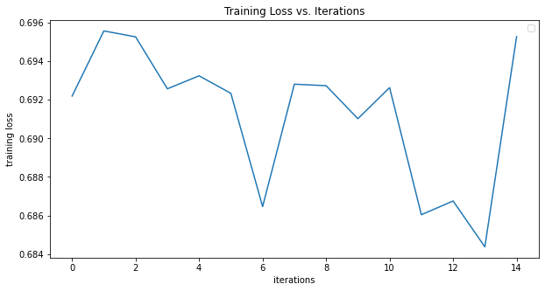
text_classification_with_TEXTnetOrder2WithEmbeddings_GloVe
Using the network and code provided in DLStudio’s TEXTnetOrder2WithEmbeddings Class but by downloading the glove-twitter-200 dataset instead of word2vec-google-news-300:
Training:
Number of layers in the model = 8
Number of learnable parameters in the model = 220,702
Epochs = 5
Batch size = 1
Hidden size = 512
Testing:
Overall classification accuracy = 51.52%
Number of positive reviews tested = 200
Number of negative reviews tested = 195
Displaying the confusion matrix:
predicted negative predicted positive
true negative: 40.513 59.487
true positive: 38.0 62.0
Example Test Output:
['at', 'mm', 'this', 'lens', 'is', 'very', 'soft', 'its', 'hard', 'to', 'get', 'a', 'shot', 'that', 'looks', 'like', 'its', 'in', 'focus', 'to', 'do', 'so', 'you', 'need', 'to', 'shoot', 'at', 'about', 'f', 'and', 'then', 'since', 'there', 'is', 'little', 'light', 'available', 'you', 'usually', 'have', 'to', 'bump', 'the', 'iso', 'to', 'or', 'just', 'to', 'get', 'an', 'acceptable', 'shutter', 'speed', 'of', 'course', 'the', 'high', 'iso', 'then', 'introduces', 'other', 'artifacts', 'the', 'focus', 'is', 'also', 'dead', 'slow', 'and', 'often', 'doesnt', 'lock', 'on', 'this', 'is', 'a', 'lens', 'that', 'i', 'have', 'constantly', 'fought', 'with', 'dont', 'upgrade', 'to', 'the', 'new', 'is', 'either', 'as', 'its', 'only', 'marginally', 'betterbuy', 'the', 'fl', 'its', 'a', 'far', 'superior', 'lens']
[i= 200] predicted_label=1 gt_label=0

Slide 10
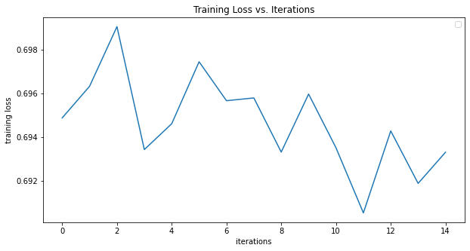
text_classification_with_GRUnetWithEmbeddings_GloVe
Using the network and code provided in DLStudio’s TEXTnetOrder2WithEmbeddings Class but by downloading the glove-twitter-200 dataset instead of word2vec-google-news-300:
Training:
Number of layers in the model = 16
Number of learnable parameters in the model = 683,002
Epochs = 5
Batch size = 1
Hidden size = 200
Testing:
Overall classification accuracy: 51.78%
Number of positive reviews tested = 200
Number of negative reviews tested = 195
Displaying the confusion matrix:
predicted negative predicted positive
true negative: 94.872% 5.128%
true positive: 90.5% 9.5%
Example Test Output:
['i', 'bought', 'this', 'model', 'a', 'year', 'ago', 'and', 'replaced', 'the', 'deck', 'after', 'approximately', 'months', 'just', 'recently', 'the', 'deck', 'cracked', 'again', 'of', 'course', 'the', 'warrantly', 'no', 'longer', 'applies', 'save', 'yourself', 'the', 'headache', 'of', 'dealing', 'with', 'this', 'company', 'and', 'spend', 'a', 'little', 'extra', 'to', 'upgrade', 'to', 'a', 'better', 'brand']
[i=100] predicted_label=0 gt_label=0

Slide 11
Task 3
I implemented a strategy that finds the average word length of the reviews and (a) pads them if they are shorter and (b) only takes the average length if they are longer. I did this because the length of the longest review is ~1400 words but the average is only ~109 words. So, the averaging strategy seemed better.

Slide 12
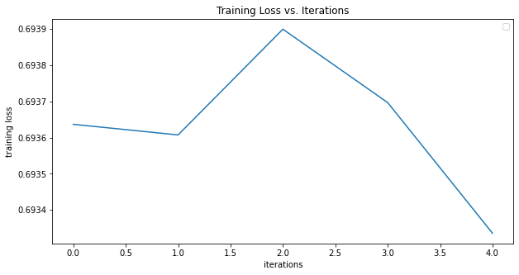
text_classification_with_TEXTnet_GloVe_word2vec.py
Using the network and code provided in DLStudio’s TextClassificationWithEmbeddings Class but by downloading the glove-twitter-200 dataset instead of word2vec-google-news-300:
Training:
Number of layers in the model = 6
Number of learnable parameters in the model = 436,558
Epochs = 5
Batch size = 2
Testing:
Overall classification accuracy = 53.06%
Number of positive reviews tested: 98
Number of negative reviews tested: 99
Displaying the confusion matrix:
predicted negative predicted positive
true negative%: 22.222% 77.778%
true positive%: 16.327% 83.673%

